Slide 1

Technology
GRADE: 5th. course.

Slide 2
Agenda
Attendance
Effective searches presentation
Class activity

Slide 3
EFFECTIVE SEARCHES
ENCOUNTER:
Say hello to students and ask them how they have been?
Attendance: Read the following quote and write in the chat what´s your opinion about it.
"It is better to fail in originality than to succeed in imitation."

Slide 4
DIALOGUE:
Do you think you are searching the Internet effectively?
Have you been frustrated by search results that are confusing or not relevant?

Slide 5
INTERNALIZE:
Formulation effective searches presentation

Slide 6
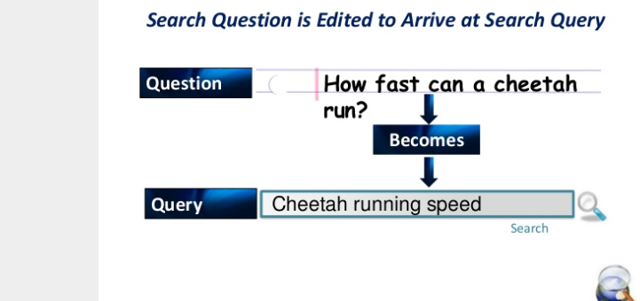

Slide 7
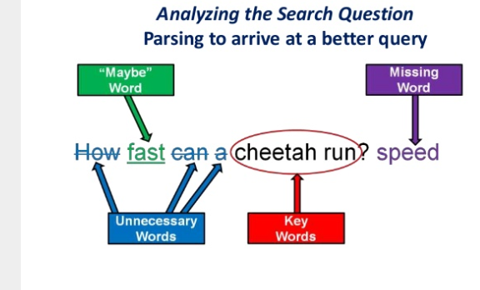

Slide 8
Questions must be scaled down to operative terms
Key words: Essential for communicating what you need. Circle them. Often they are common or proper nouns.
Maybe words: Words that might not be necessary or better expresses in an “alternative phrasing”. Underline them.
Missing words: Identify any missing information. Wht does the search engine need to identify.
Unnecessary words: Cross them out.

Slide 9
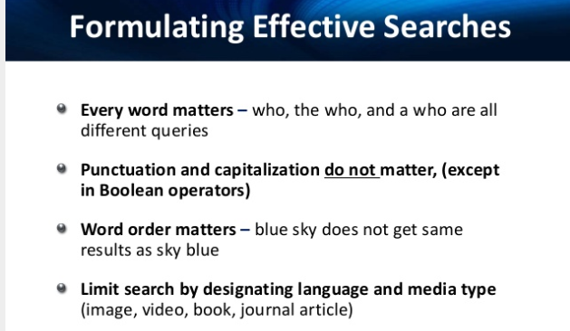

Slide 10
Formulating Effective Searches
Techniques to narrow and deepen search results
Quotation marks:Used for phrases and results will only show words as phrased “Navy Ghost Blimp”
Boolean operators qualify searches: AND, OR, NOT (always typed in uppercase)
  Ecology AND Pollution (Only results with both words)
  Ecology OR Pollution (Results with either Word)
  Ecology NOT Pollution (Results with ecology not pollution)

Slide 11
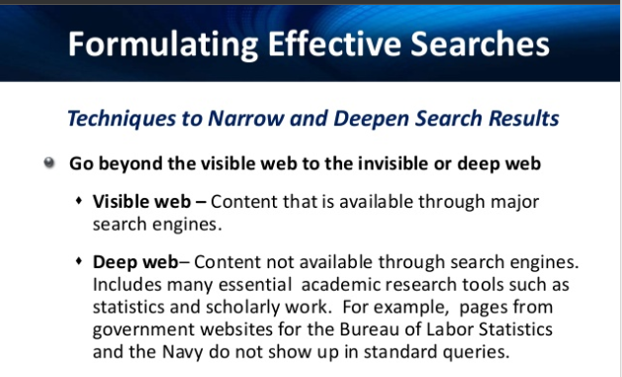

Slide 12
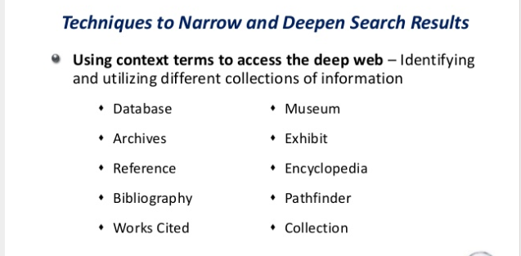

Slide 13
Using Boolean operators and context terms leads to search results fom the previously invisible Deep Web.
Example:
chinese ceramics OR database OR archive OR collections OR links
Using Minus Sign to eliminate unwanted results
A minus sign in front of a word in a query prohibits the search engine from returning any page with that word on it.
Example:
The query “eagles –Philadelphia” assures that results will not pertain to the NFL football team.

Slide 14
Use an Asterisk (*) to fill in the blank for an unknown entity.
Example the query is:
Each year, *people die of aids; the asterisk solves for N (number)

Slide 15
Use a filetype operator when searching for a specific type of file.
Example:
parts of a microscope filetype: swf (is looking for a flash file to illustrate the microscope´s parts.)
Other file extensions could be pdf, doc, jpg, gif

Slide 16
Fluent work
Go to visme.com
Create an infographic about EFFECTIVE INTERNET SEARCHES
The infographic should include:
How to scale down questions to operative terms
Deep web definition
Examples with Boolean operators
Include two techniques to narrow and deepen search results.
4. When you finish share your infographic mherrera@agustiniano.edu.gt

