Slide 1

Technology
GRADE: 2nd. course.

Slide 2
DIGITAL PRIVACY
ENCOUNTER:
Say hello to students and ask them how they have been?
Attendance: Read the following quote and write in the chat what´s your opinion about it.
"It is better to fail in originality than to succeed in imitation."

Slide 3
CLARIFY /REMEMBER:
Talk about:
Digital citizenship and why it is important to know and follow certain terms.

Slide 4
DIALOGUE:
What is Digital privacy?
Why is it important?

Slide 5
INTERNALIZE:
Presentation about digital privacy

Slide 6
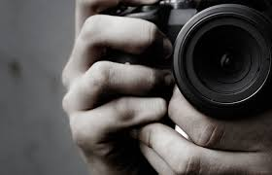
Digital privacy
Who is watching you?

Slide 7

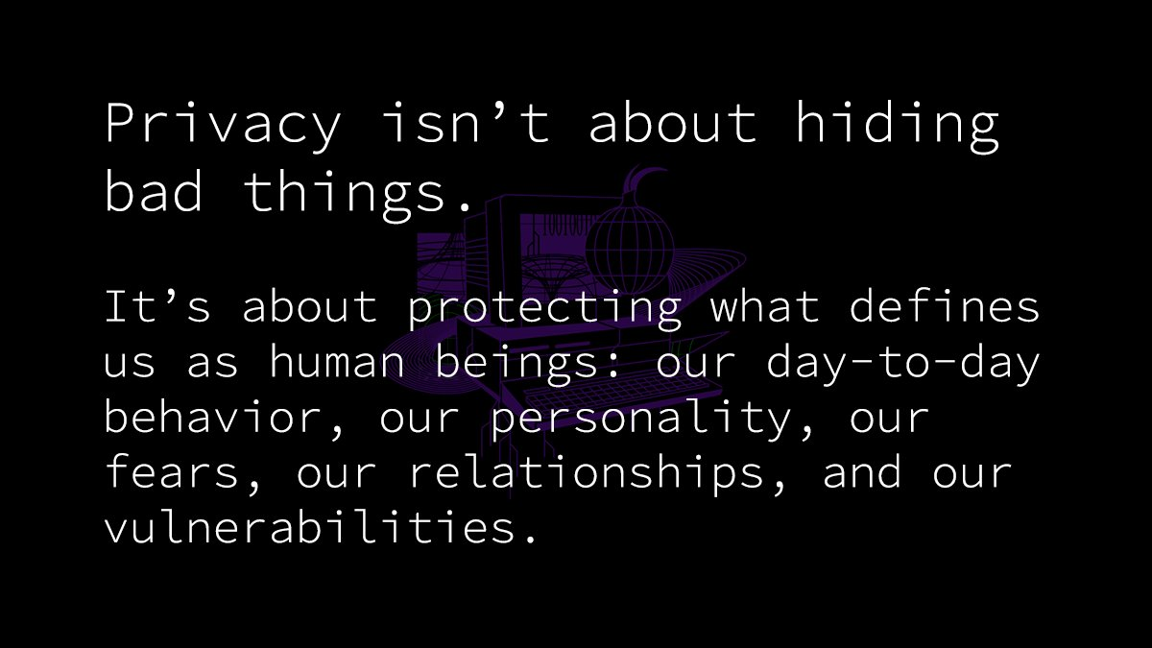
Privacy is about…
I have nothing to hide.
Privacy is about hiding bad things.

Slide 8

We share everything

Slide 9
What is digital privacy?
Digital privacy is when you can use the internet and connected devices without compromising your information.
Digital privacy then, is when the information available online about a given person is within his or her comfort zone.

Slide 10
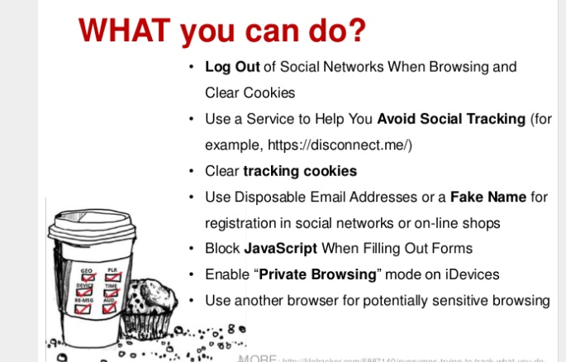

Slide 11
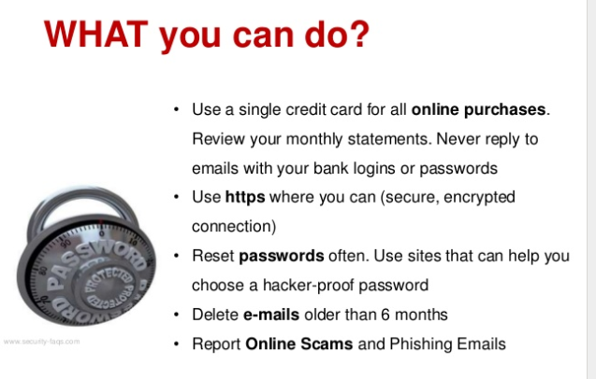

Slide 12
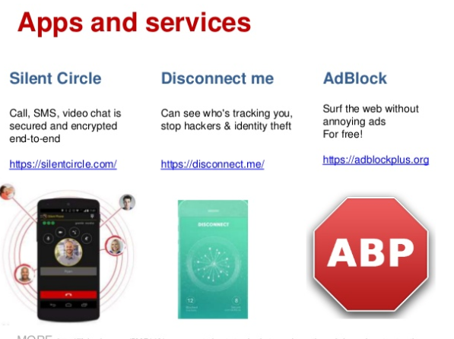

Slide 13
Fluent work
Go to visme.com
Create an infographic about DIGITAL PRIVACY
The infographic should include:
Digital privacy definition
Who is watching you when you are online?
Where did you share your information
What kind of information you shouldn´t share
Include at least five tips to help you have your digital privacy safe.
4. When you finish share your infographic mherrera@agustiniano.edu.gt

