Slide 1

Technology
GRADE: 1st. course.

Slide 2


Microphones off and cameras on

Slide 3
Agenda
Attendance
Social Networks presentation
Class activity

Slide 4
SOCIAL NETWORKS
ENCOUNTER:
Say hello to students and ask them how they have been?
Attendance: Read the following quote and write in the chat what´s your opinion about it.
"It is better to fail in originality than to succeed in imitation."

Slide 5
CLARIFY /REMEMBER:
Talk about:
Social networks
Why are they important?

Slide 6
DIALOGUE:
What social networks do you use?
What´s your favorite?
Why?

Slide 7

INTERNALIZE
Social networks presentation

Slide 8

What is a Social Network?
A social network is a network of social interactions and personal relationships.

Slide 9
Why do people use social networks?
Social networks help people keep connected with their friends and family and are an easy way to find what everyone is doing.
Social networks can also be used to find fun and interesting things on the Internet since often your friends and family will share many of the same interests as you.

Slide 10

Social media is a term for the
online platforms
that people use to connect
with others, share media content,
and form social networks.
Some of the most popular
platforms include
Facebook, Twitter,
WhatsApp,
Tumblr,
Instagram, Pinterest
Skype, YouTube and
Tik Tok.

Slide 11
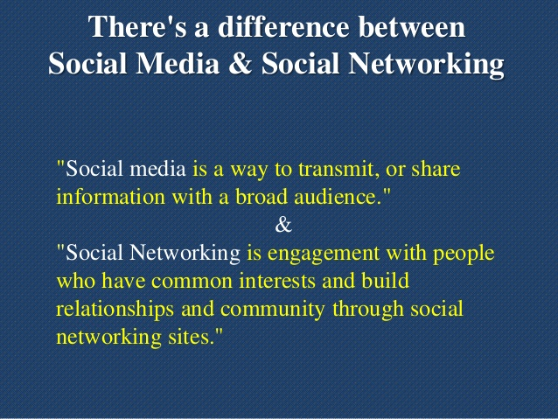

Slide 12
Advantages of Social Networks
Connect to Other People All Over the World.
Easy and Instant Communication.
Real-Time News and Information Discovery.
Great Opportunities for Business Owners.
General Fun and Enjoyment.
Educational purposes
Awareness on Social issues

Slide 13
Disadvantages of Social Networks
Cyberbullying
Hacking
Addiction
Security issues
Health issues
Glamorizes drugs and alcohol

Slide 14
Fluent work
Go to visme.com
Create an infographic about SOCIAL NETWORKS
The infographic should include:
SOCIAL NETWORKS definition
Difference between Social Networks and Social Media
Four advantages and four disadvantages of Social Networks
Definitions of two of your favorite Social Networks
Include images
4. When you finish share your infographic mherrera@agustiniano.edu.gt

